Slide 1

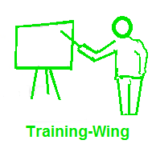
Agile Development
Awareness session
By Usman Waheed
uwaheed@bimcs.edu.pk
iuwaheed@yahoo.com

Slide 2
Agile Vs Traditional
Section

Slide 3
Agile Manifesto profile of authors at http://www.agilemanifesto.org/authors.html
Manifesto for Agile development
We are covering better ways of delivering software by doing it and helping others do it.
Through this work we have come to value:
Individuals & Interactions over processes and tools
Working software over comprehensive Documentation
Customer Collaboration over contract negotiation
Responding to Change over following a plan
That is, while there is value in the items on the right, we value the items on the left more.
Kent Beck Mike Beedle Arie Van Bennekum Alistiar Cockburn Warid Cuningham Martin Fowler | James Grenning Jim Highsmith Andrew Hunt Ron Jeffries Jon Kern Brian Marick | Robert C. Martin Steve Mellor Ken Schwaber Jeff sutherland Dave Thomas

Slide 4
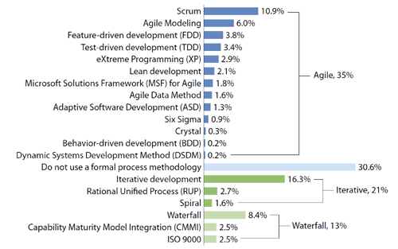
Technology Share
Source: http://www.spkaa.com/engineering-technology-services/software-engineering/workflow-process-definition

Slide 5
What will be covered– 180⁰ Shifts
Team
Requirements
Development iteration
Acceptance Tests
Programming Style
Testing
Ownership
Integration
Development Pace
Workspace
Design & architecture
Refactoring
Documentation
Task allocation
Progress meeting
Status meeting
Project status

Slide 6
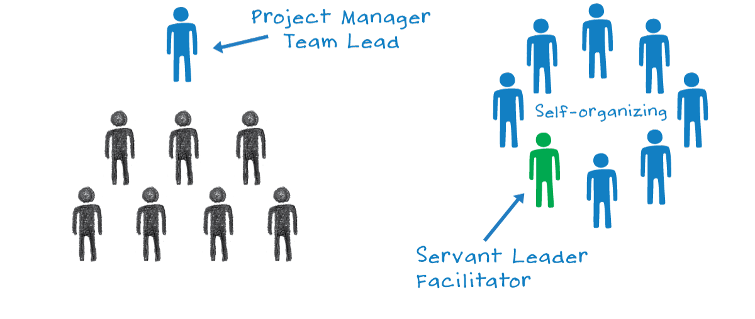
Team
Team means, analyst, designer, coder, tester, architect, team lead, QA manager, and project manager , in hieratical order
In agile development we believe in
Whole Team
in an agile project, the customer, however defined, is a member of, and available to, the team.

Slide 7
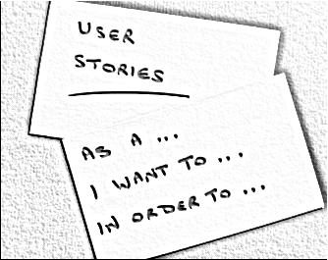
Requirements
Requirements are captured and written by analyst , and project manager and then verified from customer
In agile development we believe in
User stories by customers
the customer writes a few words on an index card .

Slide 8
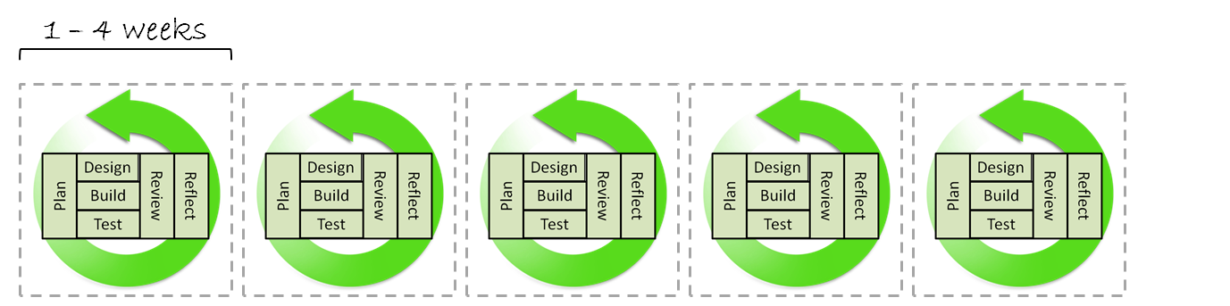
Development iteration
Projects are developed in iterations of 2-3 months, and first iteration act as detailed design and plan of the whole project, and remaining are development iterations
In agile development we believe in
Short cycle
An agile project delivers working software every two to four weeks. Each of these iterations produces working software that addresses some of the needs of the stakeholders.
At the end of each iteration, the system is demonstrated to the stakeholders in order to get their feedback.

Slide 9
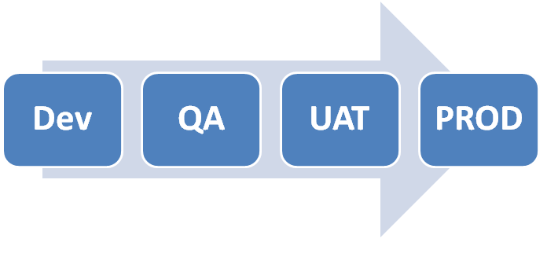
Acceptance Tests
Requirements that are captured at initial level and contracted are used as an acceptance test at the end
In agile development we believe in
Acceptance tests are written by business analysts, quality assurance specialists, and testers during the iteration.
The language they are written in is easy for programmers, customers, and businesspeople to read and understand.
Once an acceptance test passes, it is added to the body of passing acceptance tests and is never allowed to fail again.

Slide 10
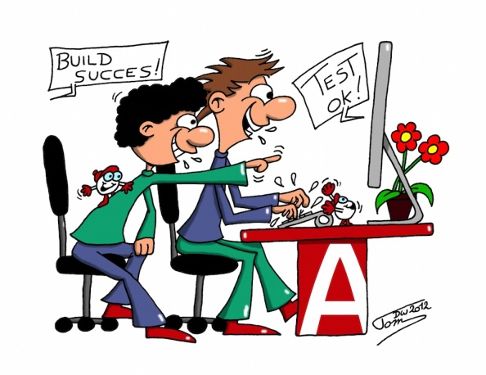
Programming Style
Each coder is assigned task by the team lead or Project manager, then QA team check for the errors
In agile development we believe in
Pair Programming
In agile Code is written by pairs of programmers working together at the same workstation. One member of each pair drives the keyboard and types the code. The other member of the pair watches the code being typed, finding errors and improvements.^{[2]} The two interact intensely. Both are completely engaged in the act of writing software.

Slide 11
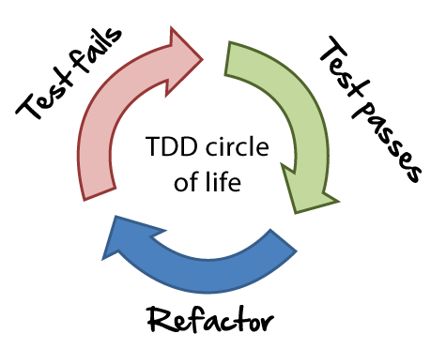
Testing
Usually test cases are developed at the time of prototype approval, then code is written by team and QA team tests the code for errors
In agile we use
Test Driven Development (TTD)
in which ,all production code is written in order to make a failing unit test pass. First, we write a unit test that fails because the functionality it is testing for doesn't exist. Then we write the code that makes that test pass.

Slide 12
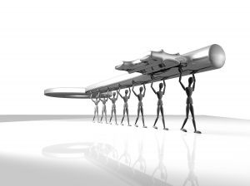
Ownership
manager is whole sole responsible for the whole project
In agile development we believe in
Collective ownership
No team member is individually responsible for any one particular module or technology. Everybody works on the graphical user interface (GUI).Everybody works on the middleware. Everybody works on the database. Nobody has more authority than anybody else over a module or a technology.

Slide 13
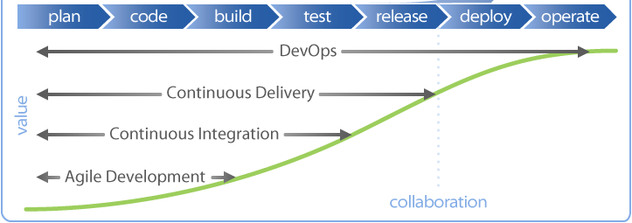
Integration
Software integration is done at the end of module and/or end of project , and is done by the QA team
I agile w believe in
Continuous integration
The programmers check their code in and integrate several times per day. The rule is simple. The first one to check in wins; everybody else merges.
So Agile teams will build the system many times each day. They build the whole system from end to end.

Slide 14
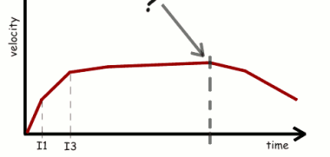
Development Pace
In software engineering,we use 80/20 principle,
in initial 20%, we develop in high speed and recover 50% of amount,
and remaining 60% in moderate speed,
and in last 20% we speed up one again
I agile we use
Sustainable Pace
A software project is not a sprint; it is a marathon.
The rule is that a team is not allowed to work overtime.

Slide 15
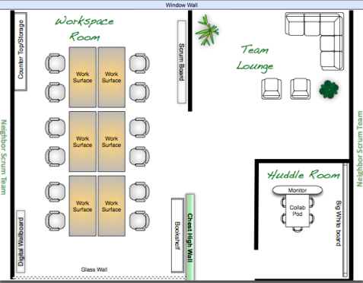
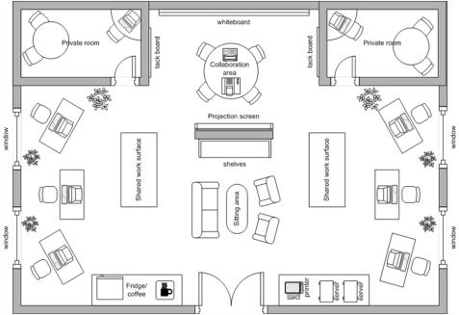
Workspace
Most of software houses have separate room/cubical of each team member, and usually tasks are assigned by the PM or via software.
Agile believes in
open workspace
The team works together in an open room. Tables are set up with workstations on them. Each table has two or three such workstations. Two chairs are in front of each workstation. The walls are covered with status charts, task breakdowns, Unified Modeling Language (UML) diagrams, and so on.

Slide 16
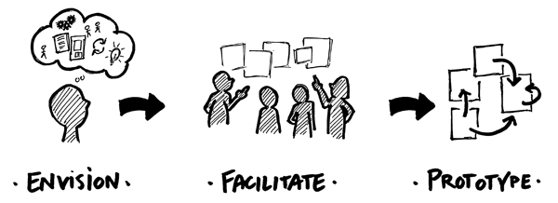
Design and Architecture
We design and architect the Whole project at the beginning .
In agile we believe in
Simple Design
An agile team makes its designs as simple and expressive as they can be. Furthermore, the team narrows its focus to consider only the stories that are planned for the current iteration, not worrying about stories to come. Rather, the team migrates the design of the system from iteration to iteration to be the best design for the stories that the system currently implements.

Slide 17
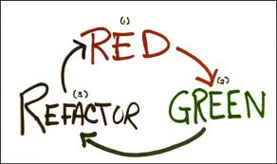
Refactoring
Refactoring is the practice of making a series of tiny transformations that improve the structure of the system without affecting its behavior. And usually done at the end of project and initiated by QA team
In agile we believe in
Continuous Refactoring
Agile teams reverse this degradation through frequent refactoring. Each transformation is trivial, hardly worth doing. But together, they combine into significant transformations of the design and architecture of the system.
Refactoring is something we do every hour or every half hour. Through refactoring, we continuously keep the code as clean, simple, and expressive as it can be.

Slide 18
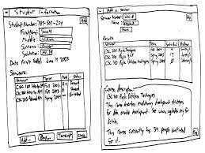
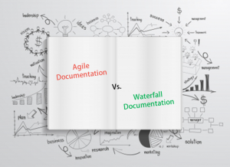
Documentation
We believe in intensive documentation of Diagrams and Specifications
In agile we believe in
Light Documentation
Produce no document unless its need is immediate and significant. Use original documents

Slide 19
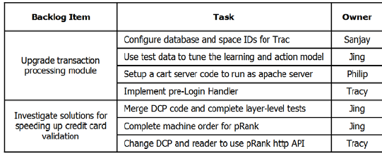
Task assignment
Project manager/team lead assigns task to whole team
In agile we believe in
Task selection
the team decides/selects how much work they will commit to complete, rather than having it assigned to them by the Product Owner.
This makes for a much more reliable commitment;

Slide 20
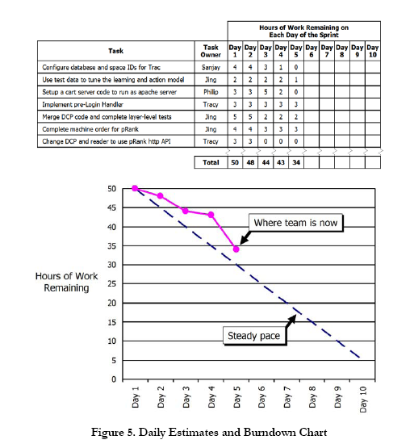
Progress monitoring
Progress of project is monitored by defining how many and how much tasks are developed
In agile we believe in
Burndown Chart
It shows, each day, how much work (measured in hours or days) remains until the team’s commitment is completed.

Slide 21
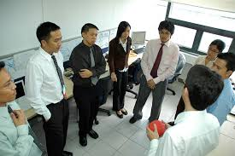
Status meeting
Progress of project is monitored/demanded PM in weekly meetings. And every one reports to PM
In agile we believe in
Daily stand up meeting
One by one, each member of the team reports just three things to the other members of the team:
What they were able to get done since the last meeting.
what they’re aiming to get done by the next meeting.
any blocks or obstacles that are in their way.

Slide 22
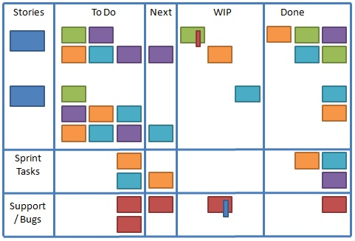
Status of project
Status of project is shown by the no of tasks that are completed
In agile we believe in
Status board
Status is shown on two sheets of poster-sized paper labeled “What’s Working Well” and “What’s Not Working, or Could Work Better” – and then have each person add several items to either.

Slide 23
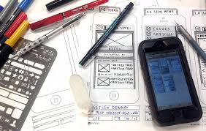

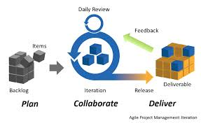
Agile Development
Agile emphasizes building working software that people can get hands on with quickly, versus spending a lot of time writing specifications up front.
Agile focuses on small, cross-functional teams empowered to make decisions, versus big hierarchies and compartmentalization by function,.
Agile focuses on rapid iteration, with as much customer input along the way as possible.

Slide 24
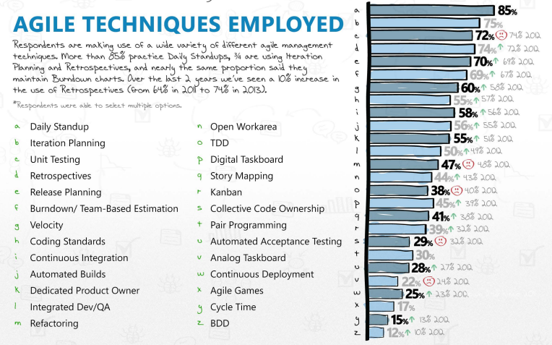

Slide 25
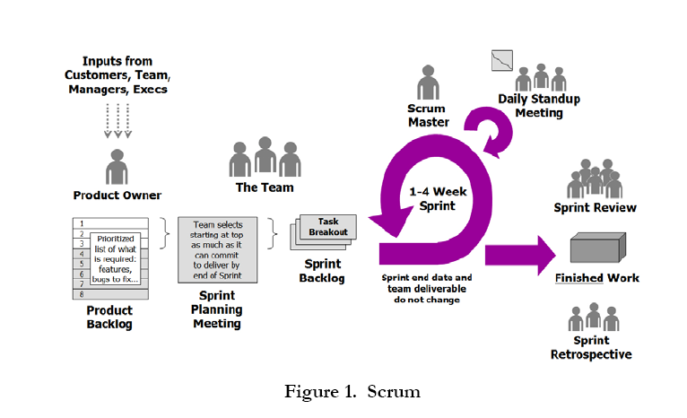

Slide 26
Thanks
Q/A

